Slide 1
Java Concepts Understanding in Depth (Head First Java In Nutshell)
Features of java
Platform Independent/portable
Simple. ...
Secure. ...
Architecture-neutral. ...
Portable. ...
Robust. ...
Multithreaded
Memory management.
Friendly syntax
Fast
Write once read anywhere

Slide 2
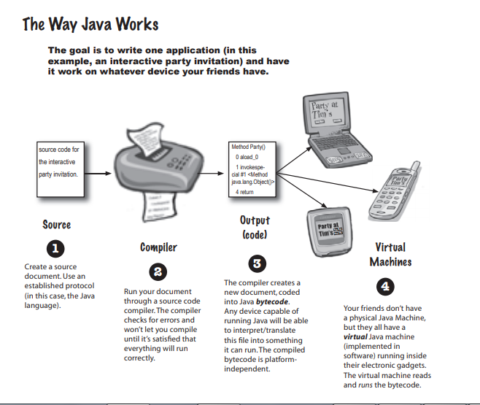

Slide 3
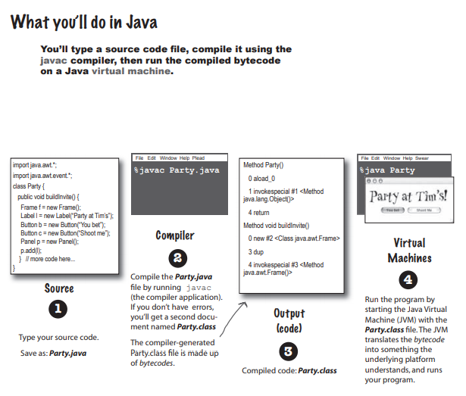

Slide 4
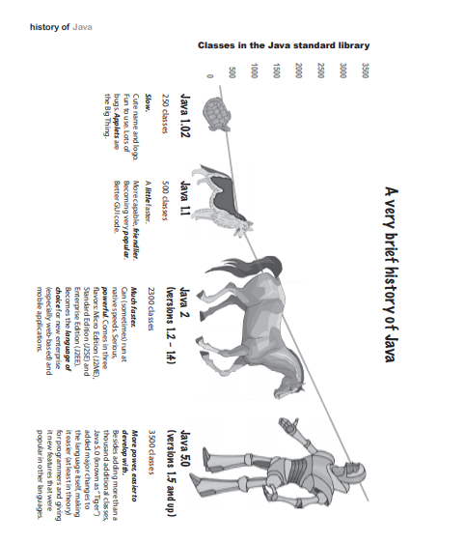

Slide 5
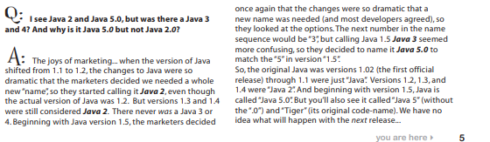
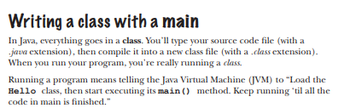
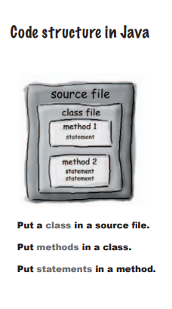

Slide 6
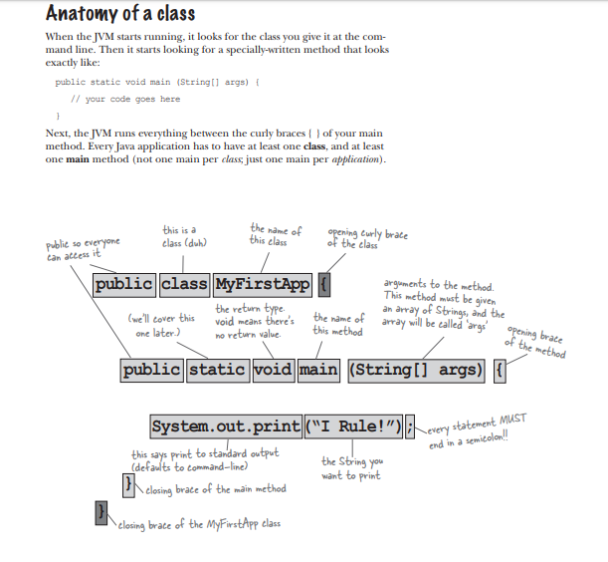

Slide 7
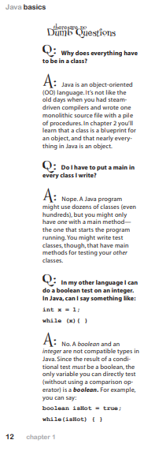
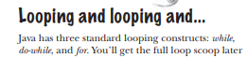
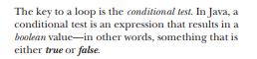
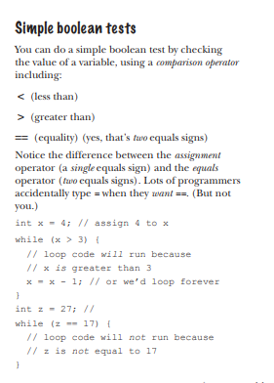

Slide 8
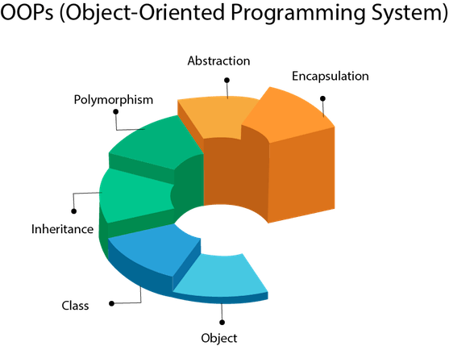
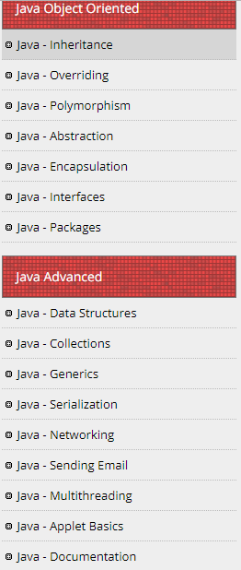

Slide 9
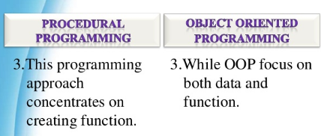
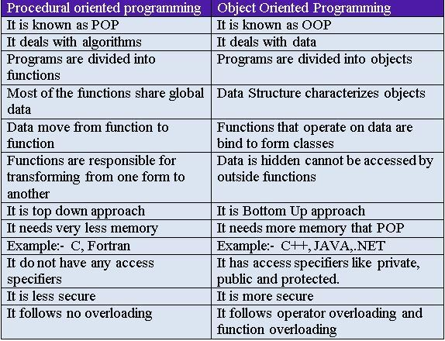

Slide 10
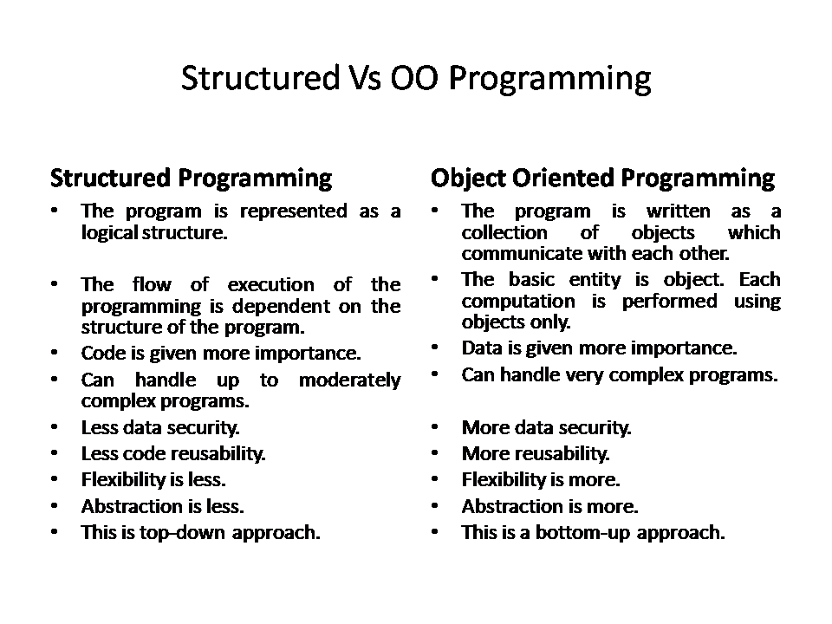

Slide 11
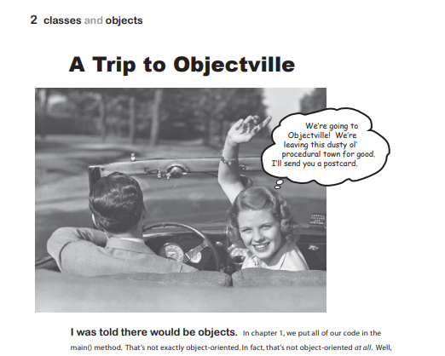
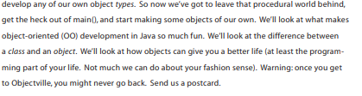

Slide 12
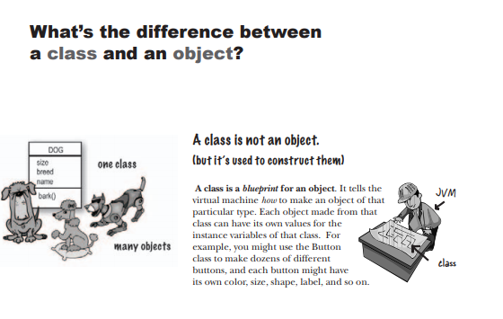

Slide 13
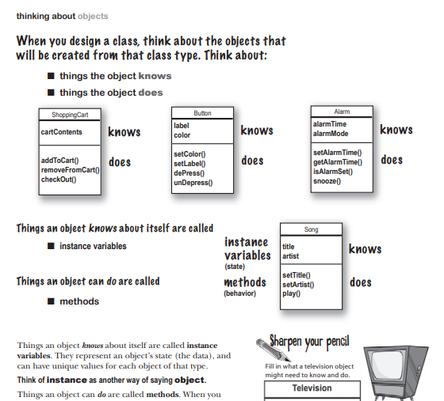

Slide 14
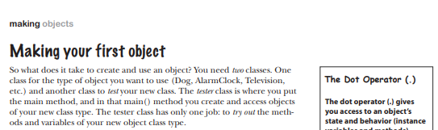
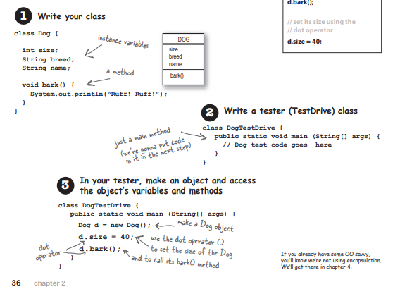

Slide 15
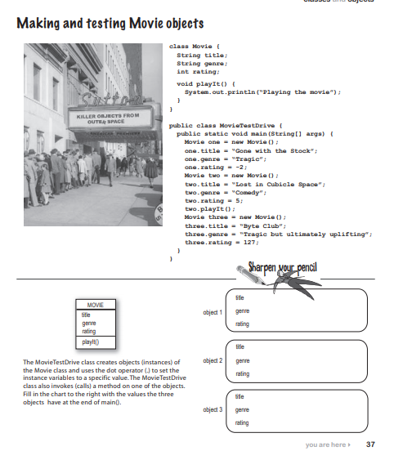

Slide 16
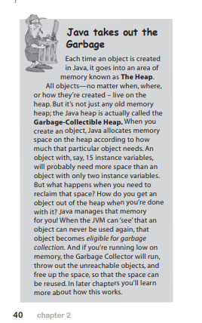
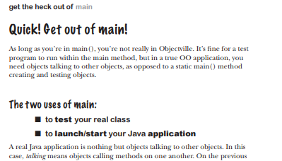
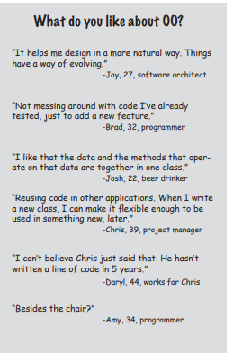

Slide 17
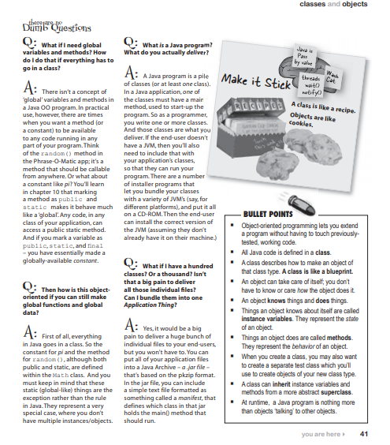

Slide 18
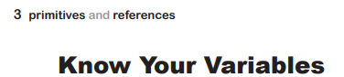
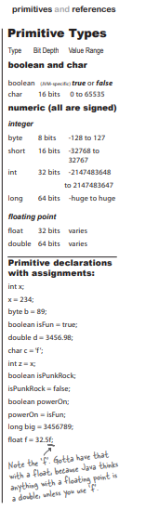
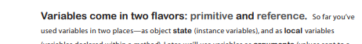
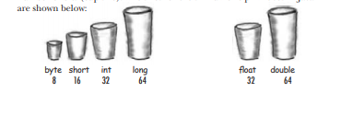

Slide 19
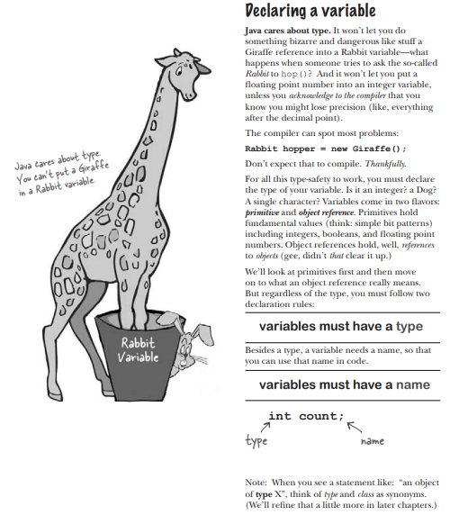

Slide 20
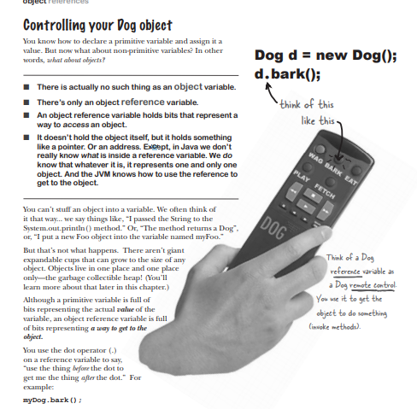

Slide 21
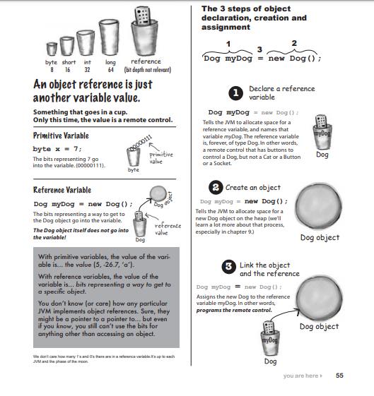

Slide 22
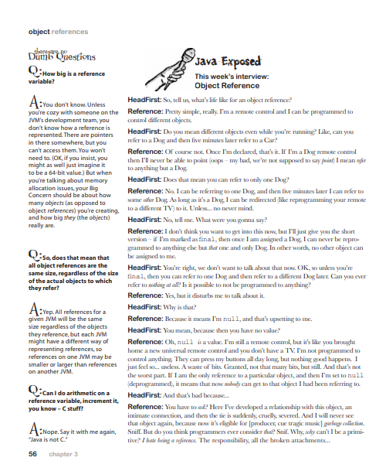

Slide 23
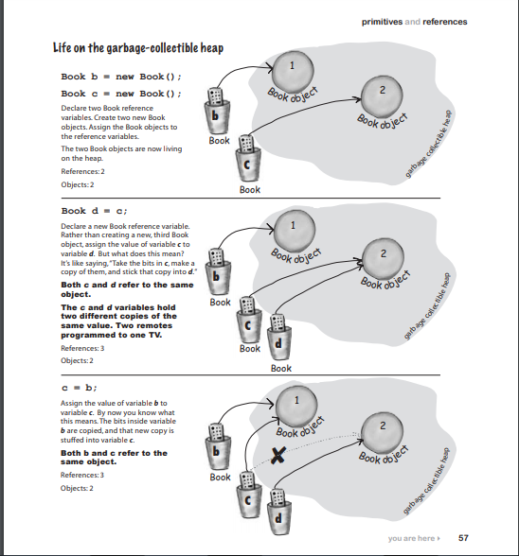

Slide 24
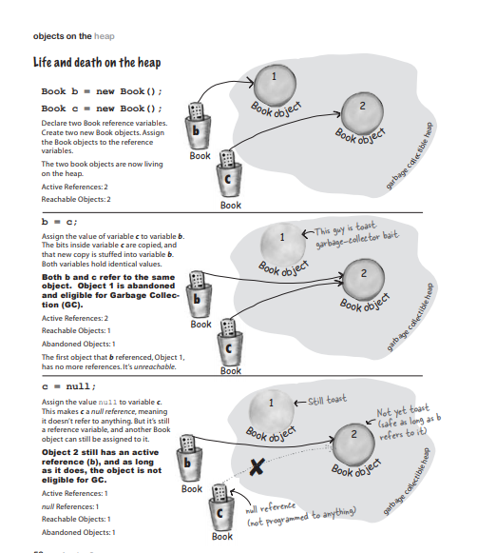

Slide 25
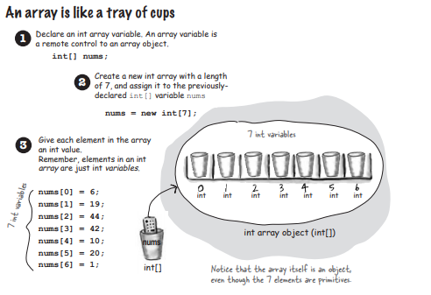
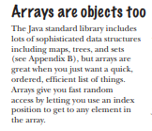
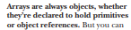

Slide 26
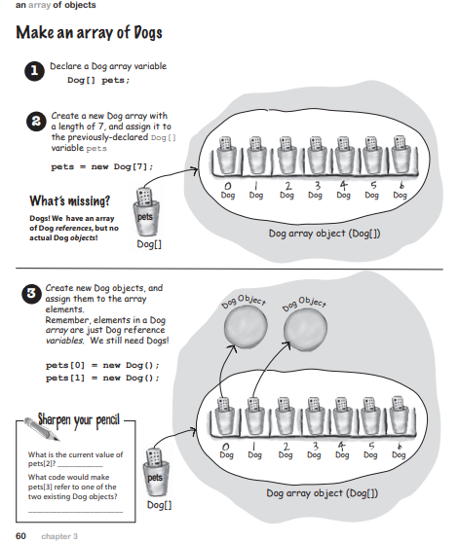

Slide 27
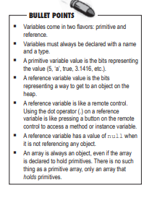
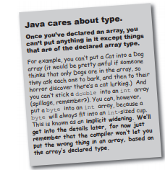

Slide 28
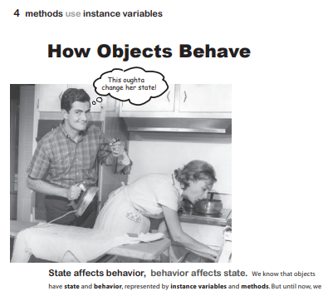
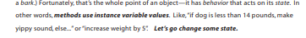

Slide 29
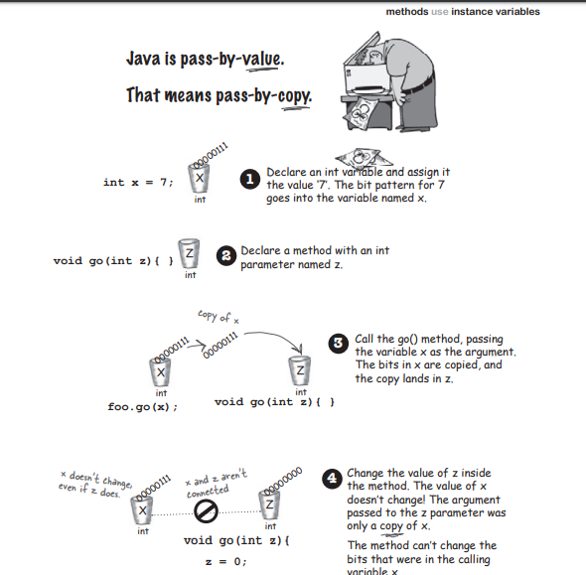

Slide 30
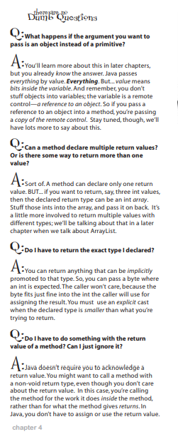
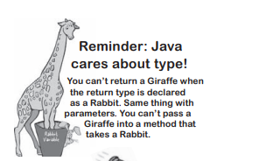

Slide 31
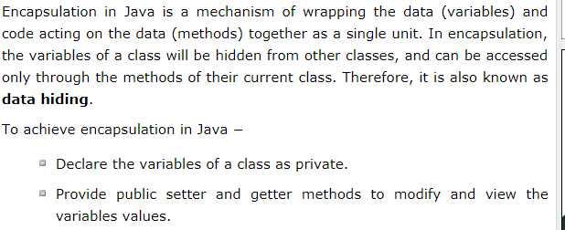
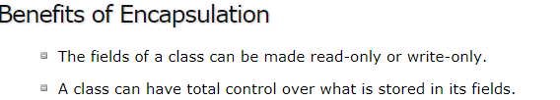

Slide 32


Slide 33





Slide 34


Slide 35


Slide 36


Slide 37


Slide 38




Slide 39




Slide 40



Slide 41



Slide 42




Slide 43



Slide 44


Slide 45



Slide 46




Slide 47





Slide 48


Slide 49




Slide 50




Slide 51


Slide 52



Slide 53



Slide 54


For Coders only*

Slide 55







Slide 56






Slide 57



Slide 58



Slide 59


Slide 60


Slide 61




Slide 62


Slide 63


Slide 64



Slide 65




Slide 66


Slide 67



Slide 68


Slide 69



Slide 70


Slide 71


Slide 72


Slide 73

Important to understand polymorphism*

Slide 74


Slide 75


Slide 76


Slide 77



Slide 78



Slide 79


Slide 80


Slide 81




Slide 82




Slide 83








Slide 84



Slide 85


Slide 86


Slide 87


For clarity only

Slide 88


Slide 89


Slide 90



Slide 91


Slide 92


Slide 93


Slide 94


Slide 95



Slide 96

Generics

Slide 97


Slide 98


Slide 99



Slide 100


Slide 101


Slide 102




Slide 104



Slide 105




Slide 106





Slide 107




Slide 108




Slide 109

Interface

Slide 110




Slide 111


Slide 112


Slide 113


Slide 114

is compulsory to implement all the methods in interface?

Slide 115


Slide 116


Slide 117



Slide 118



Slide 119


Slide 120


Slide 121


Slide 122



Slide 123


Slide 124


Slide 125


Slide 126


Slide 127



Slide 128



Slide 129



Slide 130





Slide 131




Slide 132




Slide 133



Slide 134




Slide 135



Slide 136


Slide 137


Slide 138



Slide 139



Slide 140



Slide 141






Slide 142



Slide 143



Slide 144


Slide 145


Slide 146



Slide 147





Slide 148



Slide 149


Slide 150


Slide 151



Slide 152



Slide 153



Slide 154


Slide 155



Slide 156



Slide 157


Slide 158


Slide 159




Slide 160


Slide 161


Slide 162


Slide 163


Slide 164



Slide 165


Slide 166



Slide 167


Slide 168


Slide 169






Slide 170


Slide 171



Slide 172



Slide 173



Slide 174



Slide 175



Slide 176




Slide 177



Slide 178



Slide 179



Slide 180



Slide 181



Slide 182



Slide 183



Slide 184



Slide 185



Slide 186



Slide 187



Slide 188


Slide 189



Slide 190



Slide 191



Slide 192


Slide 193


Slide 194


Slide 195



Slide 196



Slide 197



Slide 198



Slide 199



Slide 200



Slide 201



Slide 202



Slide 203



Slide 204


Slide 205


Slide 206



Slide 207



Slide 208



Slide 209



Slide 210


Slide 211


Slide 212



Slide 213



Slide 214



Slide 215


Slide 216


Slide 217



Slide 218


Slide 219



Slide 220



Slide 221



Slide 222



Slide 223





Slide 224



Slide 225



Slide 226



Slide 227



Slide 228


Slide 229



Slide 230



Slide 231


Slide 232



Slide 233



Slide 234


Slide 235


Slide 236


Slide 237



Slide 238



Slide 239


Slide 240



Slide 241


Slide 242



Slide 243


Slide 244



Slide 245


Slide 246


Slide 247


Slide 248


Slide 249



Slide 250



Slide 251




Slide 252


Slide 253


Slide 254


Slide 255


Slide 256


Slide 257


Slide 258



Slide 259


Slide 260


Slide 261


Slide 262


Slide 263



Slide 264




Slide 265



Slide 266



Slide 267



Slide 268



Slide 269



Slide 270


Slide 271


Slide 272


Slide 273


Slide 274



Slide 275




Slide 276


Slide 277


Slide 278


Slide 279


Slide 280


CompareTo(T o) is a String class method which compares 2 strings lexicographically (unicode value)).

Slide 281



Slide 282


Slide 283


Slide 284



Slide 285


Slide 286



Slide 287


Slide 288


Slide 289



Slide 290


Slide 291



Slide 292


Slide 293



Slide 294


Slide 295


Slide 296



Slide 297



Slide 298



Slide 299



Slide 300



Slide 301



Slide 302



Slide 303



Slide 304


Slide 305



Slide 306


Slide 307


Slide 308


Slide 309


Slide 310


Slide 311


Slide 312


Slide 313


Slide 314


Slide 315


Slide 316


Slide 317


Slide 318


Slide 319



Slide 320


Slide 321



Slide 322


Very Imp Concepts (for interview)

Slide 323


Slide 324



Slide 325


Slide 326



Slide 327


Slide 328


Slide 329


Slide 330




Slide 331



Slide 332




Slide 333


Slide 334


Slide 335



Slide 336


Slide 337

Very imp interview question

Slide 338



Very imp interview question

Slide 339


Slide 340


Slide 341



Slide 342


Very Imp

Slide 343




Slide 344




Slide 345



Slide 346



Slide 347


Slide 348



Slide 349


Slide 350



